Slide 1
ALERT SYSTEM FOR CHANGE IN WEATHER CONDITIONS
Name: Mihika V Malgi USN : 2GI16EC075
Name: Priya P Shetti USN : 2GI16EC109
Name:Mohommad Faiz Bawa USN: 2GI16EC078
Name: Poonam A Patil USN : 2GI16EC101
Under the guidance of:
Dr. Veena Desai
Professor (Dept of EC ) KLS-GIT

Slide 2
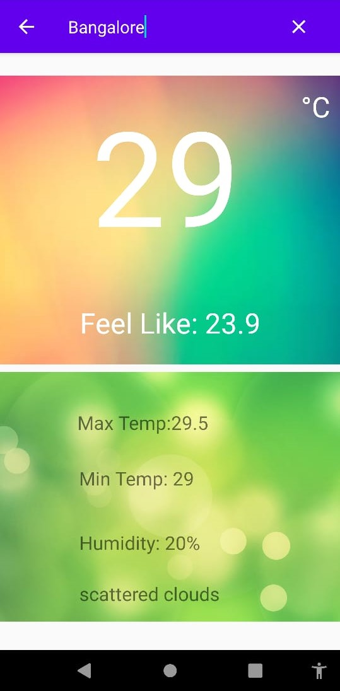
UI : Android app
The user interface for the ML code is as fig.1
Aim is for relatively easy interface.
Name of the region or city for which weather data is displayed is on the top of the app
Fig.1 App for display of weather

Slide 3
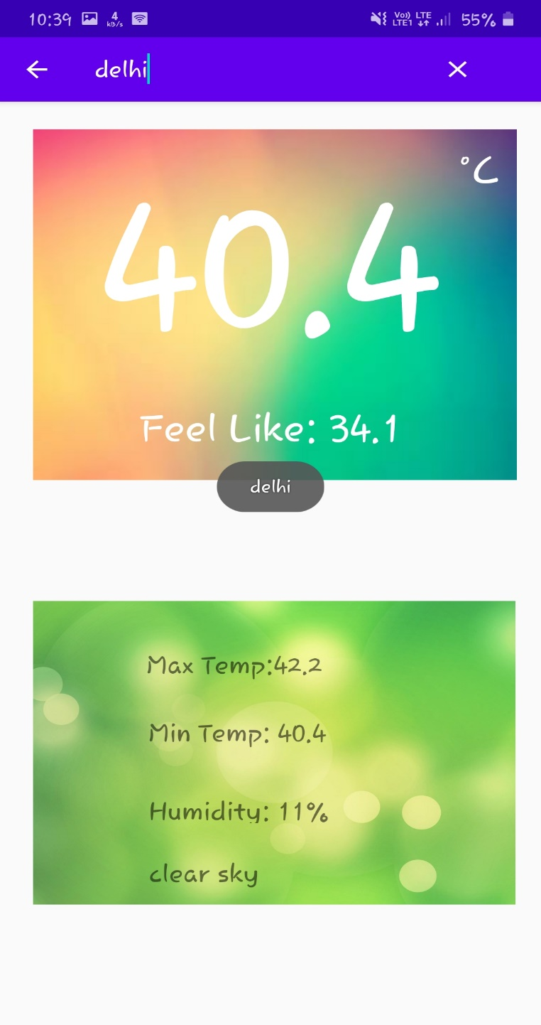
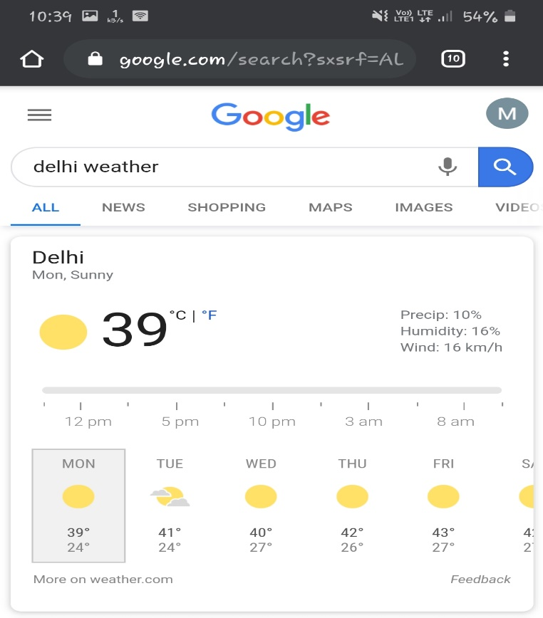
Comparison

Slide 4
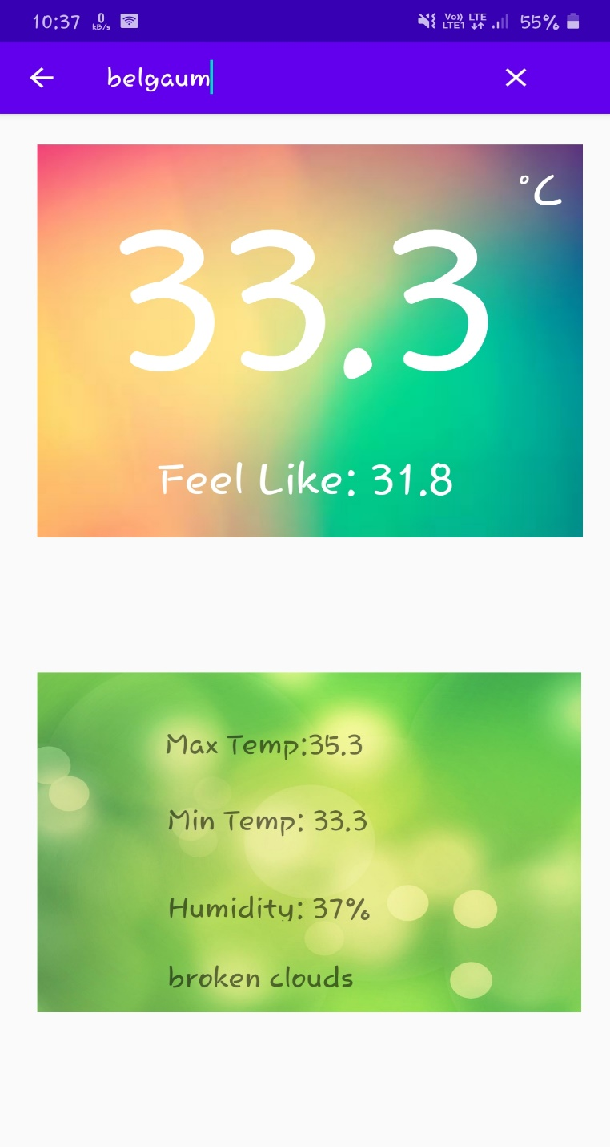
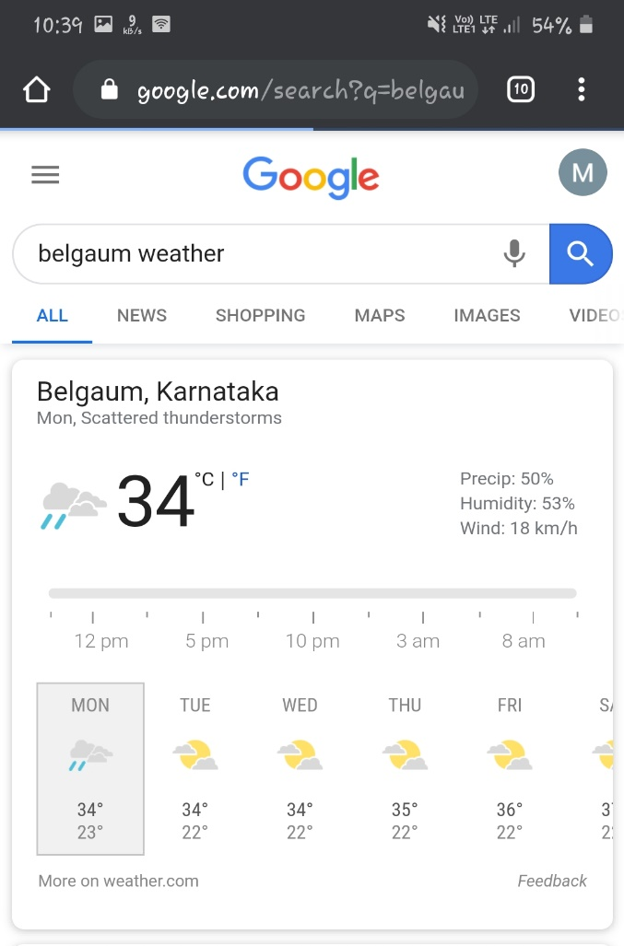
Comparison

Slide 5
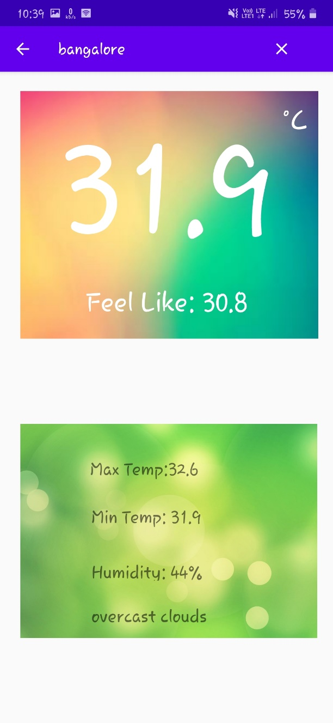
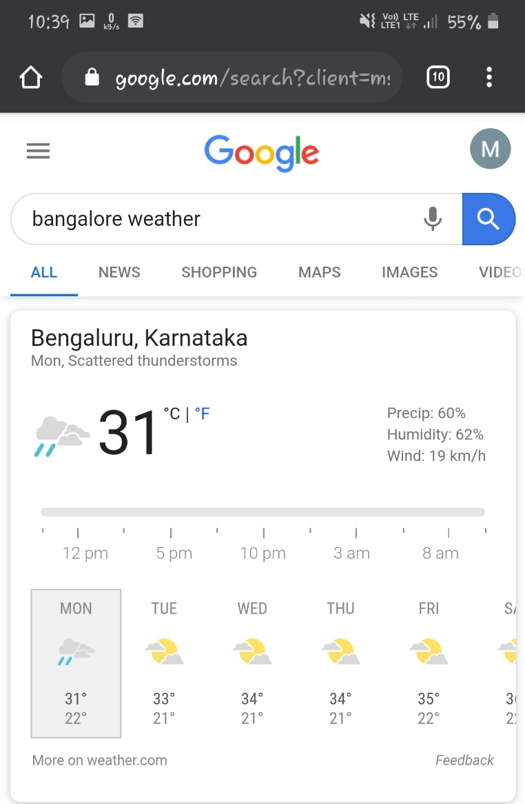
Comparison

Slide 6
Deploy ML Weather Prediction Code
Model Building: A suitable Machine learning Model pipeline to Predict the weather using the datasets from WWO is build.
Setup API : Create an API using flask server.
App : Here, we will design a user interface where the user can type his region.
Get the data: Once we get the region from the user, we will use the API to get the data related to the searched location.
Predict weather and send results: Next, use the saved model to predict the weather of the region and send the results back to the app.

Slide 7
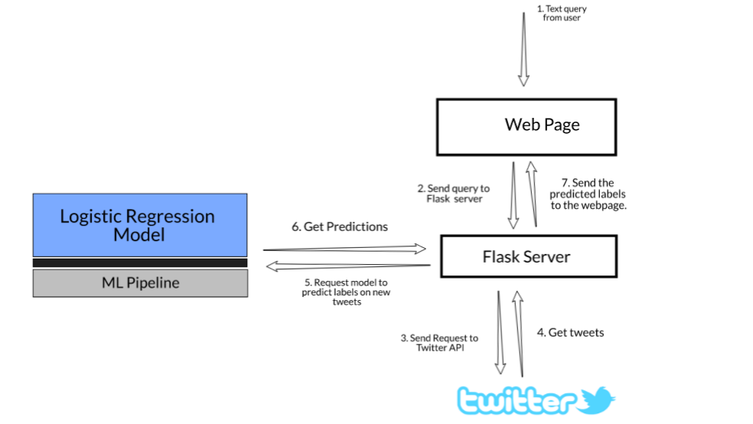
Deploy ML Weather Prediction Code
App
Machine learning
Model
App
data
data
WWO
World weather online
Fig.2 Flow diagram to deploy ML code

Slide 8
Further update for the App
A new page in the android app for the display of future predicted weather.
Alert system in the form of push notification for the app

